Slide 1
Package Nomenclature
<cc><UT><VS><pack><duration>
INWMPVDIYDPFY
IN – India
WM – Wikitek Mechanik
PV - Pass Vehicles
DIYDP – Diagnostics Pack
FY – Full Year
INRMPVOSFY – In current scope
miBud
Used by the service users
wikitek1
One app for various User types, vehicle segments, packages
Used by service providers
Country | User Type (UT) | Vehicle Segment (VS) | Packages(pack) | Duration
IN - India | Wikitek Mechanik (WM) | 2W – 2 wheeler | Diagnostics Pack (DIYDP) | FY – Full Year
 | Mobitek Mechanik (MM) | 3W – Auto Rick | Operations Pack (OP) | HY – Half Year
 | RSAngel Mechanik (RM) | PV – Passenger Vehicles | Assisted Diagnostic Pack (ADP) | QY – Quarter Year
 |  | CV – Commercial Vehicles

Slide 2
Action: Reject
JC: ClosedByCustomer
JC:QuoteForTransport
Action – Arrange Transport
JCPickup record Created
Action – Quote for Transport
JC:ApproveForTransport
JC: Pickup
JCPickup: Open
Action – Start for Pickup
RS Manager
JC: Pickup
JCPickup: StartedPickup
Action – Reached Customer
RS Technician (on the vehicle)
JC: Pickup
JCPickup: ReachedCustomer
JC: Open
Action – Quote for Service
Action – Vehicle Picked Up
miBud
JC: Pickup
JCPickup: Pickedup
Action – Close Pickup Ticket
JC: Pickup
JCPickup: Closed
Mobitek / RSAngel Mechanik
Ops workflow
Rejected
JC: ClosedByCustomer
Approved: JCSession Created
JC: Service
JCS: Open
Action – Start Service
JC: QuoteForService
JC: Service
JCS: Started
JC: ApproveForService
Action – Close Service
JC: Service
JCS: Closed
JC: ClosedApproved
Action – Approve Service
JC: ClosedDisapproved
Action – Reject Service

Slide 3
Pickup = true
Action – Reject Transport
JC: ClosedByCustomer
JC:QuoteForTransport
Action – Arrange Transport
Approved: JCPickup Created
Works manager
Action – Quote for Transport
JC:ApproveForTransport
JC: Pickup
JCPickup: Open
Action – Start for Pickup
Service advisor
Wikitek mechanik
JC: Pickup
JCPickup: Started
Pickup = false
JC: EntryCheck
Action – Reached Customer
Technician
JC: Pickup
JCPickup: ReachedCustomer
JC - Open
Action – Vehicle Picked Up
miBud
Action – Arrange Entry Check
JCEntryCheck Created
JC: Pickup
JCPickup: Pickedup
Action – Close Pickup Ticket
JC: Pickup
JCPickup: Closed
wikitek Mechanik
Ops workflow
JC: EntryCheck
JCEnC: Open
Rejected
JC: ClosedByCustomer
Action – Start Entry Check
JC: EntryCheck
JCEnC: Started
Approved: JCSession Created
JC: Service
JCS: Open
Action – Entry Check Done
Action – Start Service
JC: EntryCheck
JCEnC: Closed
JC: QuoteForService
JC: Service
JCS: Started
Action – Send Quotation
JC: ApproveForService
Action – Complete Service
JC: Service
JCS: Closed
JC: ExitCheck
JCExC: Open
JC: Drop
JCDrop: Open
Action – Start Exit Check
Action – Arrange Entry Check
Action – Start for Drop
JC: ExitCheck
JCExC: Started
JC: ExitCheck
Action – Complete Exit Check
JC: Pickup
JCDrop: Started
Drop valid
JC: Drop
Action – Arrange Drop
Action – Reached Customer
JC: ExitCheck
JCExC: Closed
JC: Pickup
JCDrop: ReachedCustomer
JC: ClosedApproved
Action – Approve Ticket
Action – Vehicle Dropped
Drop Invalid
JC: AwaitClosurefromCustomer
JC: Pickup
JCDrop: Closed
JC: ClosedDisapproved
Action – Reject Ticket

Slide 4
miBud

Slide 5
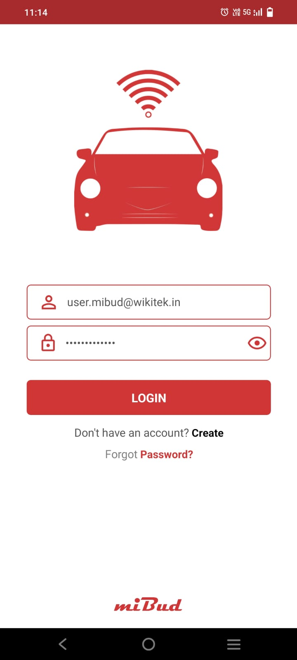
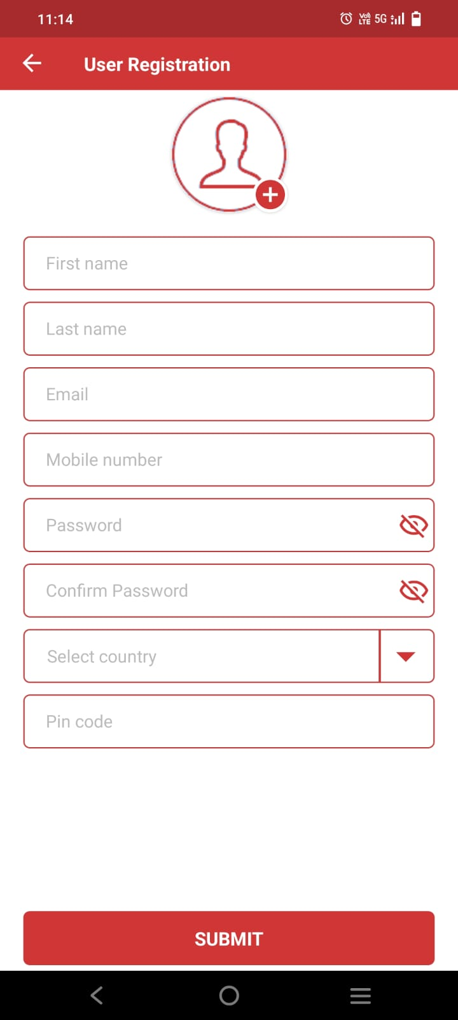
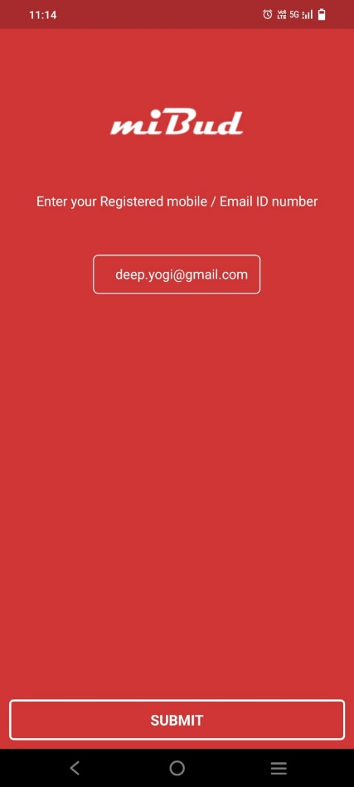
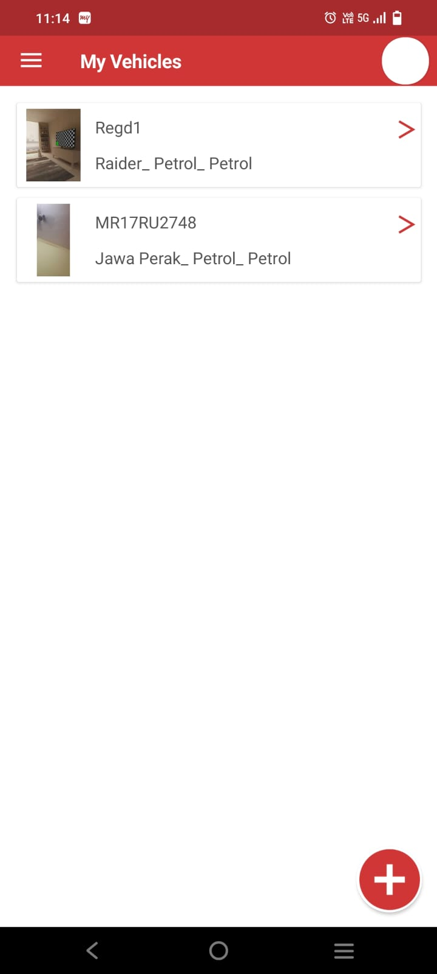
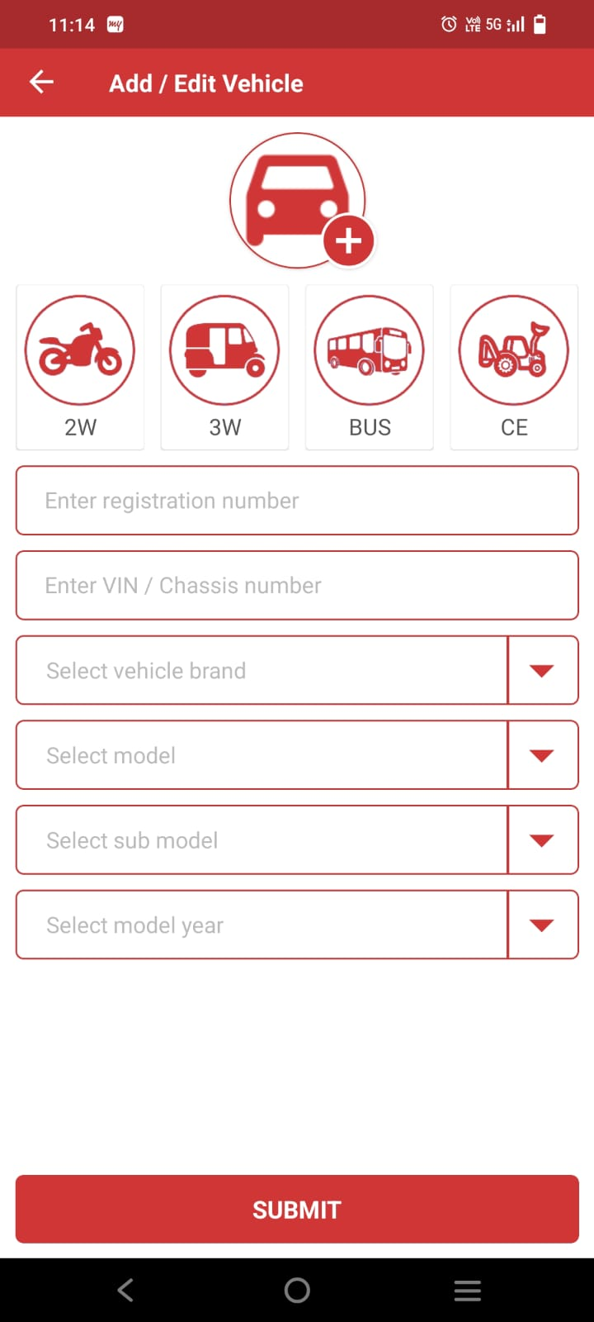
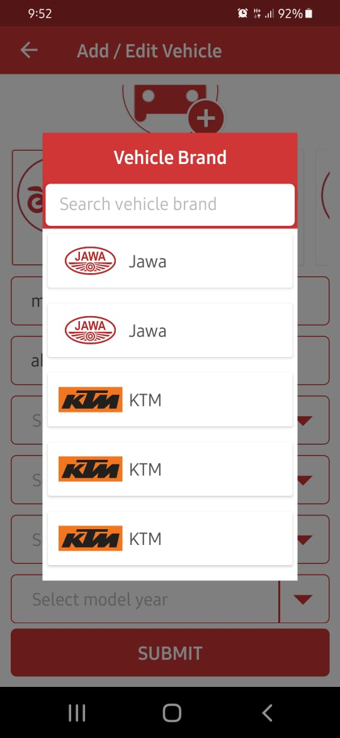
Provide login by otp also as an option. Instead of forgot password, put OTP Login. This way, he can login and later change his password inside
Use only mobile number. No email required. Until otp authentication happens, don’t approve the user. Until user is approved, he cannot login
This screen will not be there as we will not have forgot password option
Remove the circle on top right.
Remove the > symbol, once vehicle is crated, it cannot be edited / changed
when new vehicle is created, have blank page and say Add vehicle.
We shud have brands shown only once. Same with model, submodel, modelyear

Slide 6
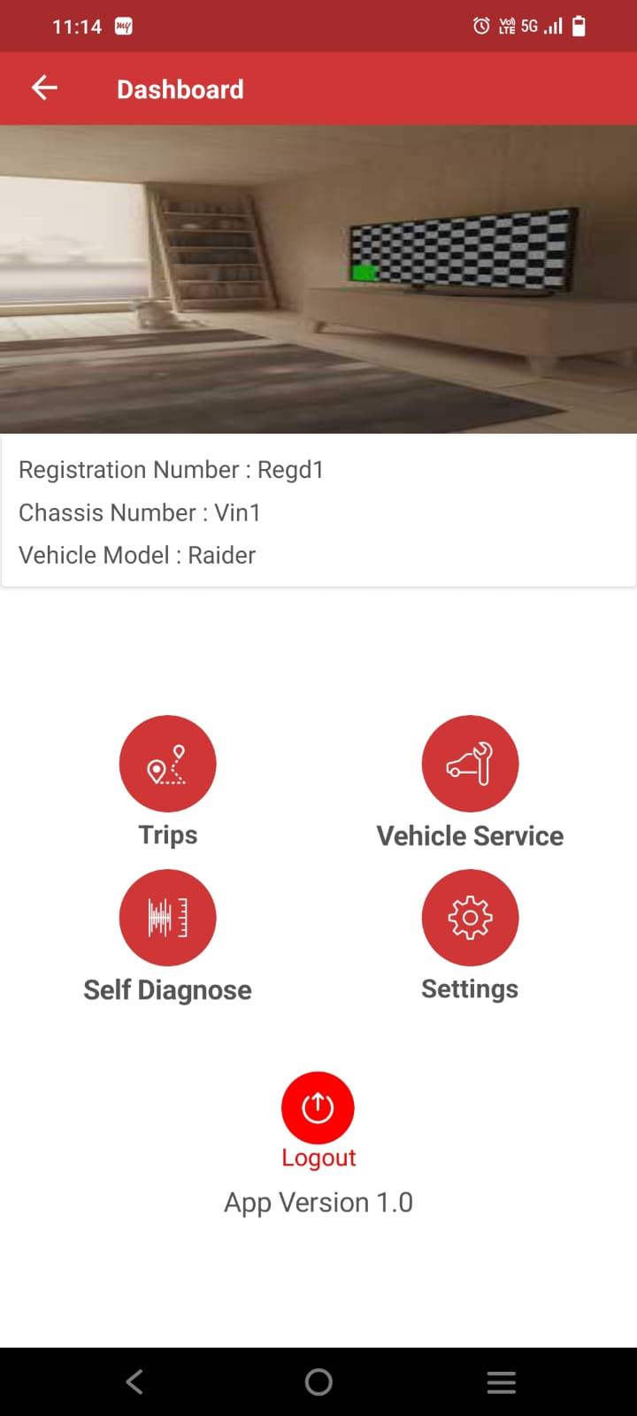
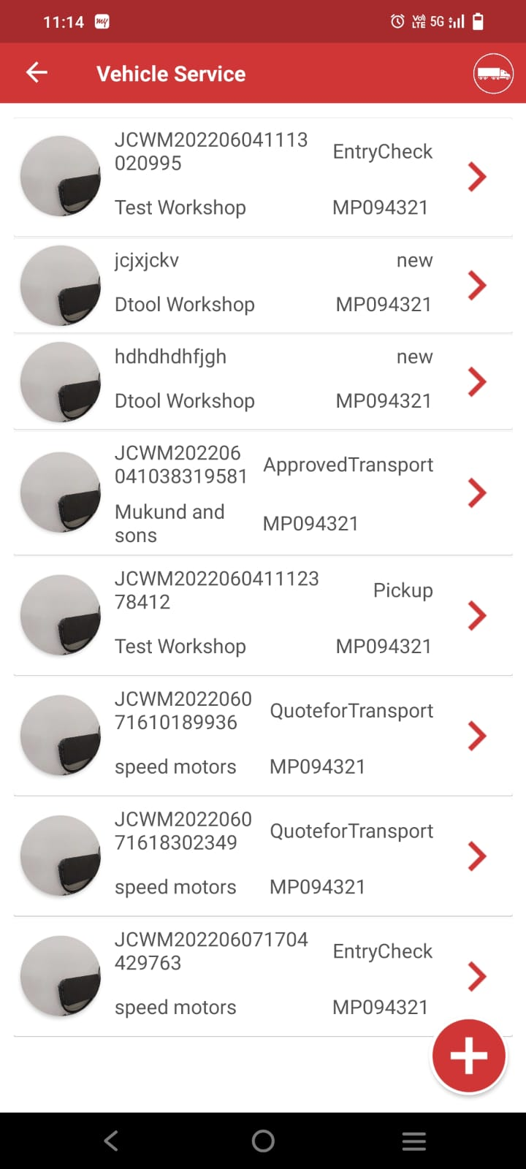
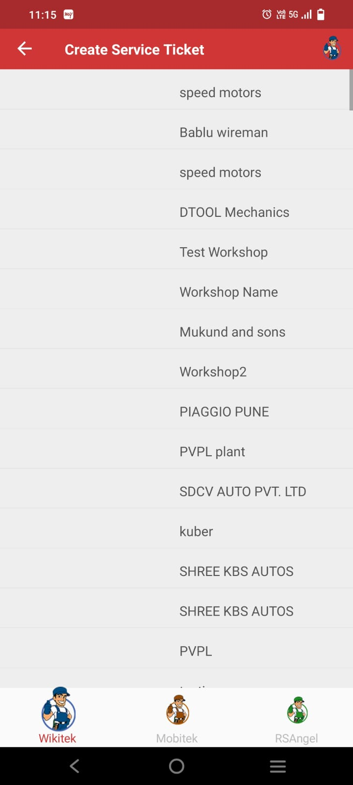
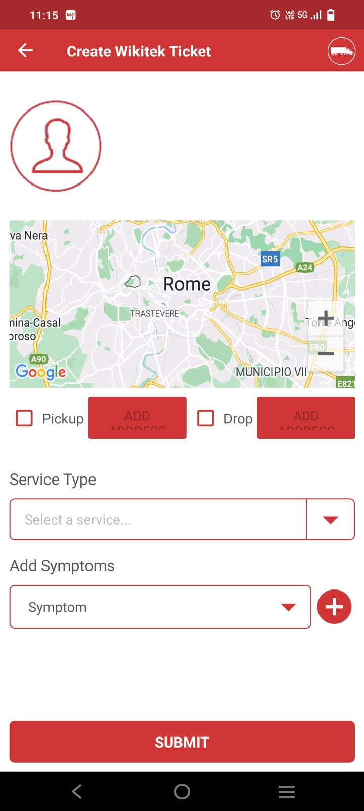
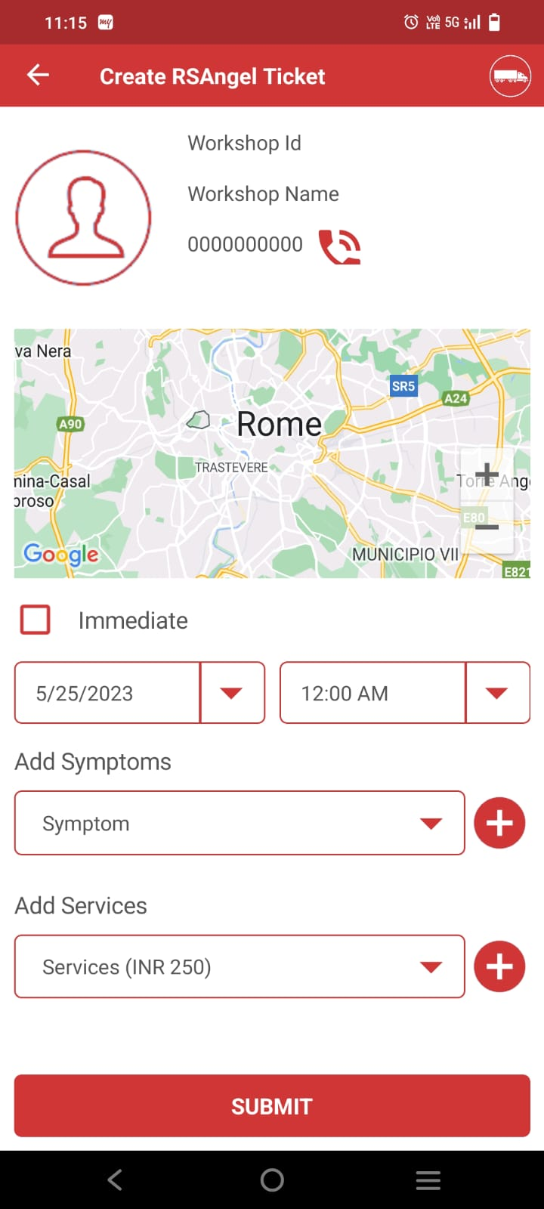
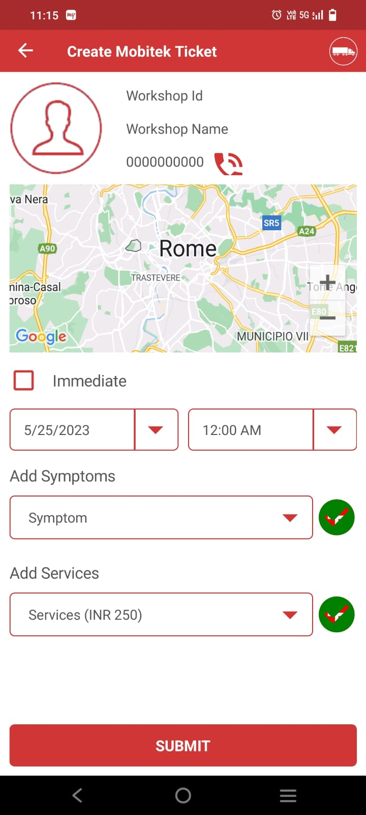
Remove Trips. Settings and logout from here. First line would have Wikitek Mechanik, Mobitek Mechanik, RSAngel Mechanik
Second line would have Self Diagnose
Based on which one is selected, show only those service ticket (by user type)
Based on which user type is selected, show appropriate pic on top right. Remove the link from that. Show only those user types on map. Below remove the 3 icons. And have book nearest, and book selected only. Once this is clicked, display next service detail page
Based on which user type is selected, show appropriate pic on top right. Remove the link from that. Show only those user types on map. Below remove the 3 icons. And have book nearest, and book selected only. If picture not attached, show workshop icon here. Map should show route from current to workshop. If pickup / drop enabled, add date and time. Select one service type and one or more symptoms
In case on mobitek / rsangel, only service date and time would be shown.
Workshop ID
Workshop Name
Address:
This will book the service ticket

Slide 7
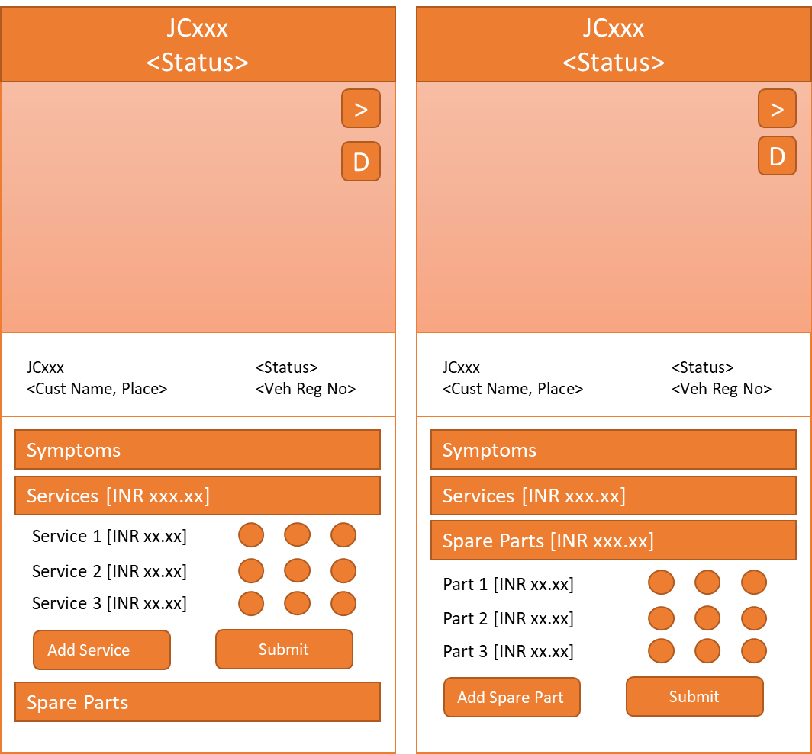
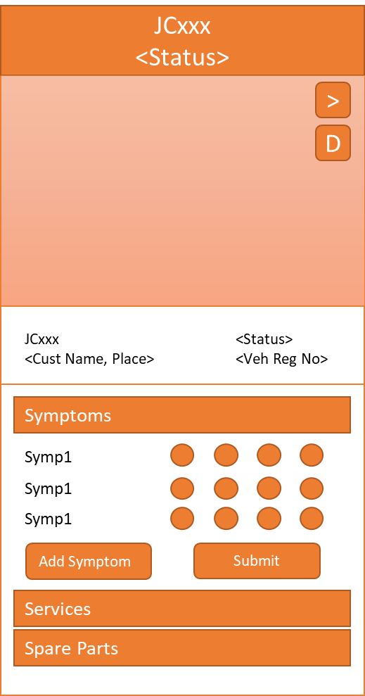
Shud be able to add multiple symptoms and multiple services. By default immediate clicked and current date and time should show up but disabled, if Immediate disabled, current date time can be changed. Remove mobile number from these pages and replace with Rating (5 star). We will introduce soon in the backend. Get rid of + buttons. We shud be able to add multiple in the same box (with search)
Service Detail heading should have Job card no instead.
Below pic, it should have 3rd row, Created and Last Updated date / time
Symptom should have customer symp, wikitek1 symptoms in rows and later should show tick like the below window. Same with services and spare parts
Action would depend on the current status of the order
By clicking Detail, it should show the order page with detailed breakdown of services and spare parts.
Opening existing job cards

Slide 8
wikitek1

Slide 9

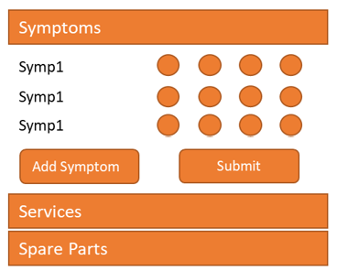
JCxxx
Quote for Transport
JCxxx
Quote for Service
JCxxx
Arrange Pickup
Customer ID:
Customer Name: Name / Mob
Location:
Pickup @ Date / Time:
RS Vehicle Selected:
RS Technician: Name (Mob)
Customer ID:
Customer Name: Name / Mob
Location:
Mobile No:
Pickup @ Date / Time
RS Vehicle Selected:
RS Technician: Name (Mob)
Customer ID:
Customer Name: Name / Mob
Location:
Mobile No:
Pickup @ Date / Time
RS Vehicle Selected:
RS Technician: Name (Mob)
Map view with customer place and current location of vehicle
Veh Reg NO
VIN
Veh Reg NO
VIN
Model-SM-MY
Model-SM-MY
Assign Vehicle
Veh Reg NO
VIN
Model-SM-MY
Distance to Customer
Distance to nearest workshop
Service Quote (Excl GST)
Send Quotation
Transport Quote (Excl GST)
Send Quotation
TBD by workshop Manager

Slide 10
JCxxx
Start for Pickup
JCxxx
Pickup Reached Customer
JCxxx
Vehicle Picked up
JCxxx
Pickup Closed
Customer ID:
Customer Name: Name / Mob
Location:
Pickup @ Date / Time:
Customer ID:
Customer Name: Name / Mob
Location:
Pickup @ Date / Time:
Customer ID:
Customer Name: Name / Mob
Location:
Pickup @ Date / Time:
Customer ID:
Customer Name: Name / Mob
Location:
Pickup @ Date / Time:
Map view with customer place and current location of vehicle
Map view with customer place and current location of vehicle
Map view with customer place and current location of vehicle
Map view with customer place and current location of vehicle
Veh Reg NO
VIN
Veh Reg NO
VIN
Veh Reg NO
VIN
Model-SM-MY
Model-SM-MY
Model-SM-MY
Veh Reg NO
VIN
Distance to Customer
Distance to nearest workshop
Distance to Customer
Distance to nearest workshop
Distance to Customer
Distance to nearest workshop
Model-SM-MY
Distance to Customer
Distance to nearest workshop
Pickup OTP from Customer
Started for Pickcup
Reached Pickup Location
Vehicle Dropped
Picked Up
TBD by workshop Technician

Slide 11
JCxxx
Start Service
JCxxx
Close Service
Customer ID:
Customer Name: Name / Mob
Location:
Pickup @ Date / Time:
Customer ID:
Customer Name: Name / Mob
Location:
Pickup @ Date / Time:
Map view with customer place and current location of vehicle
Map view with customer place and current location of vehicle
Veh Reg NO
VIN
Veh Reg NO
VIN
Model-SM-MY
Model-SM-MY
Distance to Customer
Distance to nearest workshop
Distance to Customer
Distance to nearest workshop
Started Service
Closed Service
TBD by workshop Technician

Slide 12
JCxxx
Approve / Reject Transport
JCxxx
Approve / Reject Service
RSA ID:
RSA: Name
Pickup @ Date / Time:
RS Agent:
RS Technician: Name
RSA ID:
RSA: Name
Pickup @ Date / Time:
RS Agent:
RS Technician: Name
Map view with customer place and current location of vehicle
Veh Reg NO
VIN
Model-SM-MY
Distance to Customer
Distance to nearest workshop
Veh Reg NO
VIN
Model-SM-MY
Distance to Customer
Distance to nearest workshop
Transport Quote (Incl GST)
Transport Service (Incl GST)
Make Payment
Reject
Make Payment
Reject
TBD by miBud

Slide 13







wikitek1
Only appears for managers
Registration
Vehicle Mgmt
Technician Mgmt
Dashboard
Marketplace
My Orders
Select Language
Sync Data
Logout
Vehicle Management
Map view with my vehicle locations and details. Also, if they are free / busy. If vehicle selected, only show that on the map
DASHBOARD
Vehicle Management
First Name
Scrolling pics
KA01 DA 0099
Free
Select Vehicle Number
Last Name
xxx hrs / xxx hrs
Technician
Select User Type
KA01 DA 0010
Free
Select Vehicle Segment
xxx hrs / xxx hrs
Technician
KA01 DA 0012
Free
Email ID
xxx hrs / xxx hrs
Technician
Mobile No
Diagnostics
Assisted Diagnostics
Operations
Password
Hot Products
Confirm Password
Select Country
Pincode
Details of vehicle movement
+
submit

Slide 14
Associate Vehicle
Disassociate Vehicle
KA01 DA 0099
Assign Technician
Enter Vehicle Reg No
Select Vehicle Reg No
Reg No: xxx
VIN No: xxx
Owner: x x
Run Hrs: xxx hrs / xxx hrs
Status: Associated
Reg No: xxx
VIN No: xxx
Owner: x x
Run Hrs: xxx hrs / xxx hrs
Status: Associated
Get OTP
Reg No: xxx
VIN No: xxx
Owner: x x
Run Hrs: xxx hrs / xxx hrs
Status: Associated
Select Available Technician
Assign Technician
Get OTP
Send OTP
Get OTP
Disassociate
Send OTP
Send OTP
Only get unassociated technicians
Only get available technicians

Slide 15
Technician Management
Add Technician
Username
Assign Vehicle
Disassociate Technician
User Name
User ID
Enter Technician ID
User ID: xxx
User Name: xxx
User Type:
Status: Associated
User ID: xxx
User Name: xxx
User Type:
Status: Associated
User ID: xxx
User Name: xxx
User Type:
Status: Associated
Status
Availability
Get OTP
User Name
User ID
Status
Availability
Select Available Vehicle
Select Technician
User Name
User ID
Assign Vehicle
Get OTP
Get OTP
Status
Availability
Send OTP
Disassociate
Send OTP
Send OTP
+
Only get disassociated technicians
Only get available vehicles

Slide 16
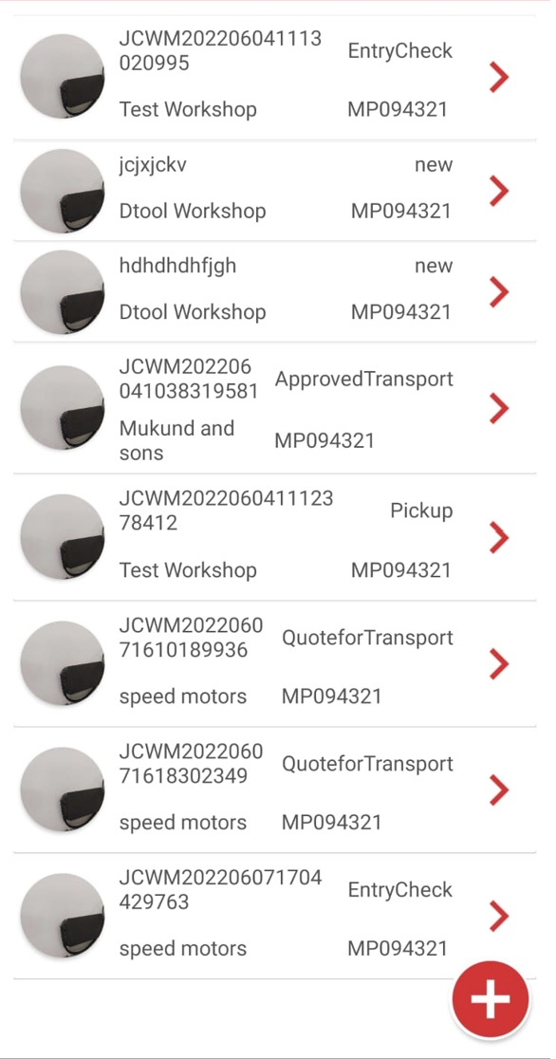
My Jobcards

